Slide 1

Introduction to D3

Slide 2
D3’s data model
visual form
data
selection

Slide 3
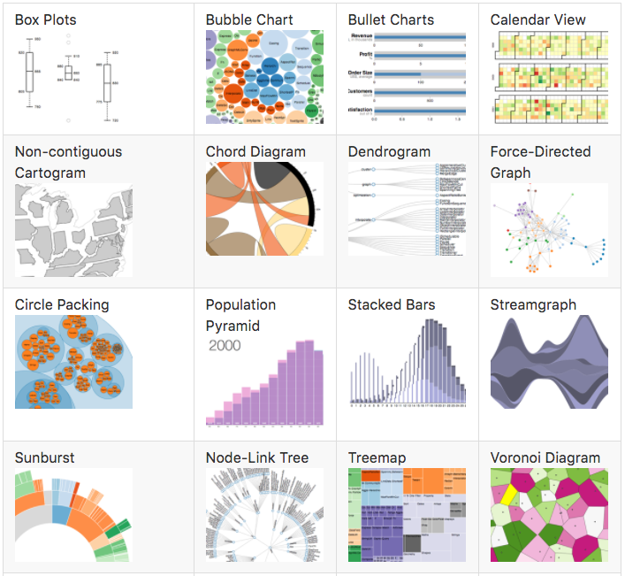
What can D3 build

Slide 4
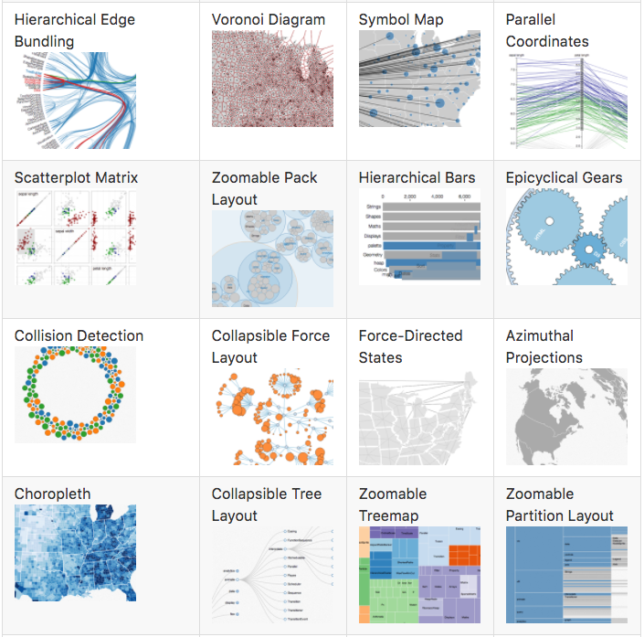
What can D3 build

Slide 5


Slide 6
D3 technologies
HTML
CSS
JS
SVG
The DOM

Slide 7
Web programming 101
We ended up with this:

Slide 8
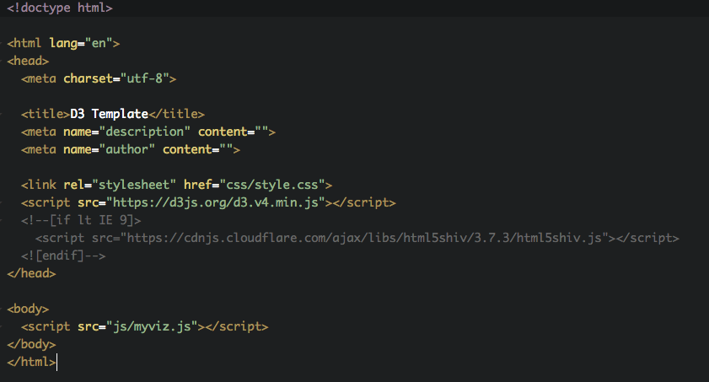
Getting started with D3

Slide 9
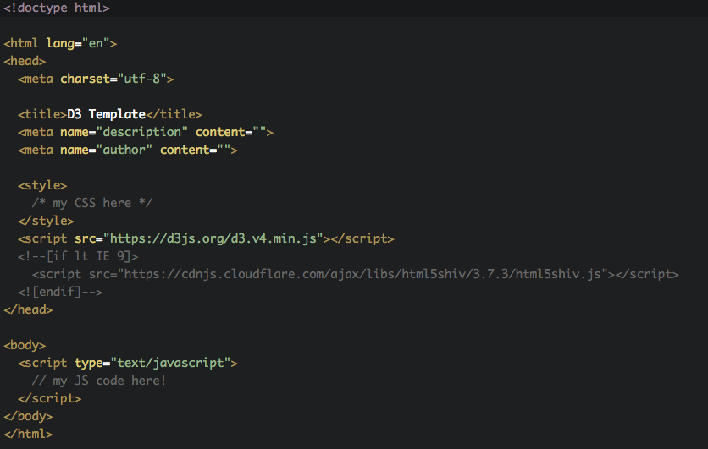
Getting started

Slide 10
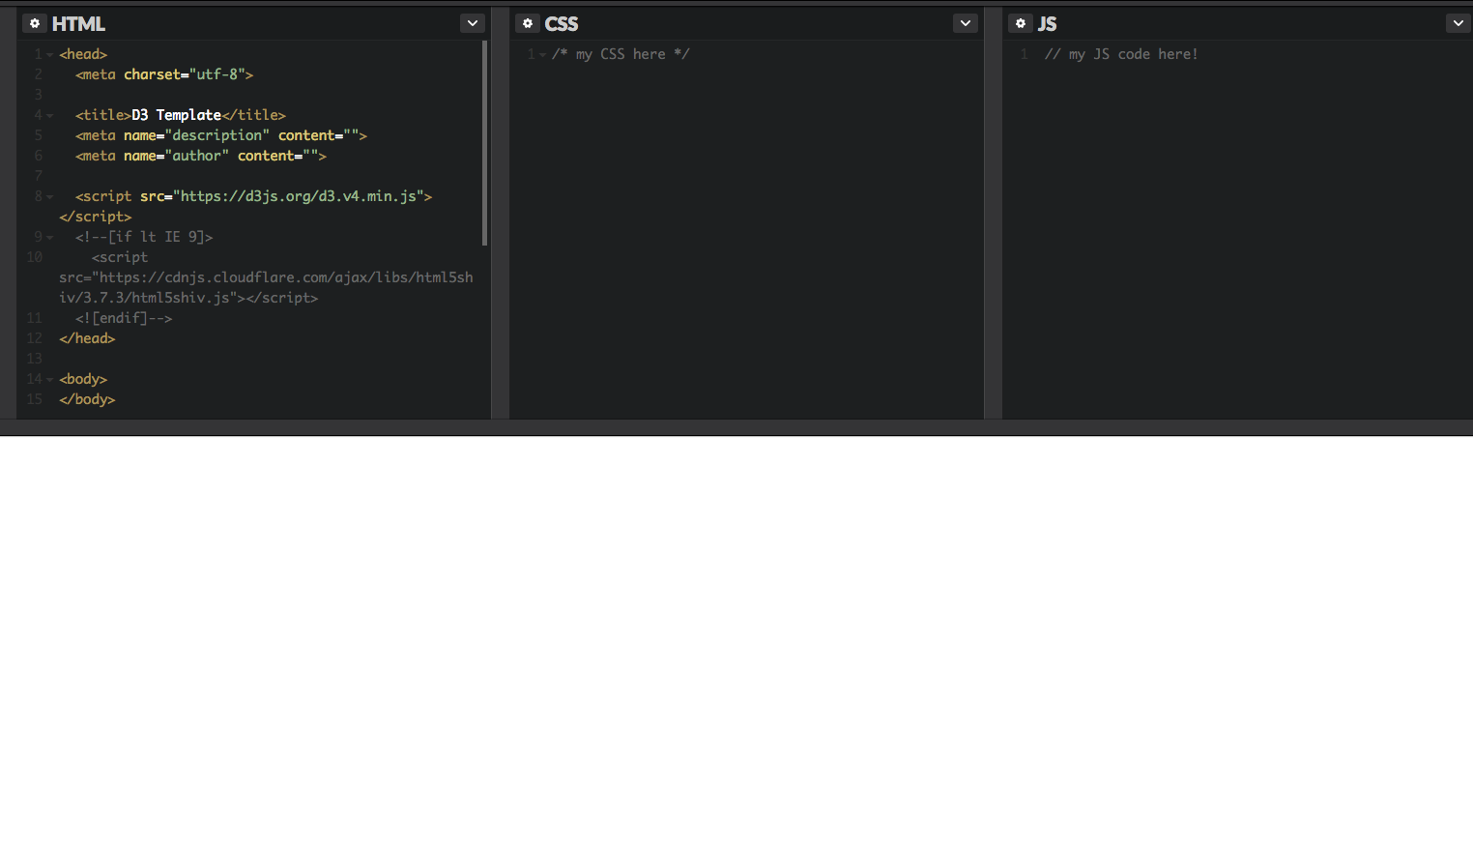
How this works in CodePen

Slide 11
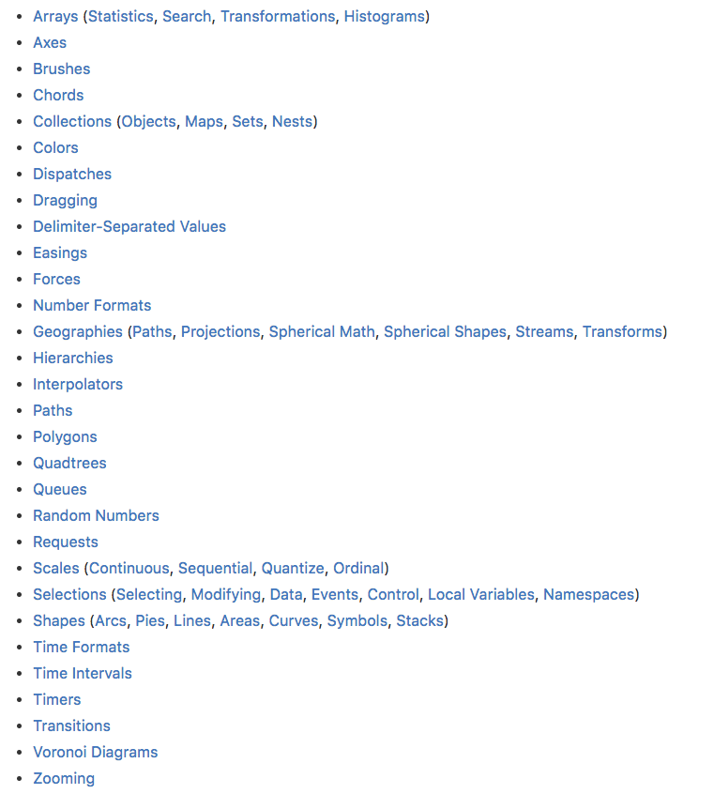
D3 arrives at version 4
D3 is made up of
many, small modules
From the D3 API Ref:
https://github.com/d3/d3/blob/master/API.md

Slide 12
History: from Protovis to D3
Described in D3: Data-Driven Documents
http://idl.cs.washington.edu/papers/d3
Elaboration on the design of D3 API in What Makes Software Good
https://medium.com/@mbostock/what-makes-software-good-943557f8a488

Slide 13
How not to learn D3
Use only existing templates.

Slide 14
Let’s get started
The most important module in D3 is the selection: d3.selection().
D3 works by creating, updating, modifying, and removing selections.
Always reference the API docs when it’s unclear: https://github.com/d3/d3-selection

Slide 15
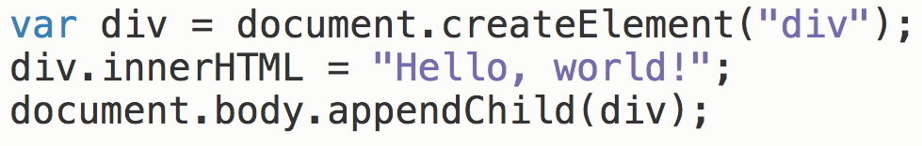
Selecting an element

Slide 16
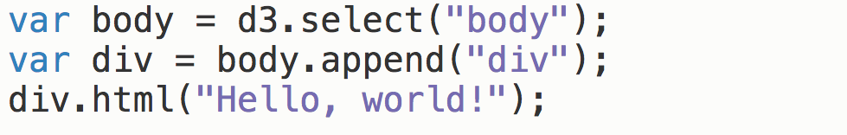
Selecting an element

Slide 17
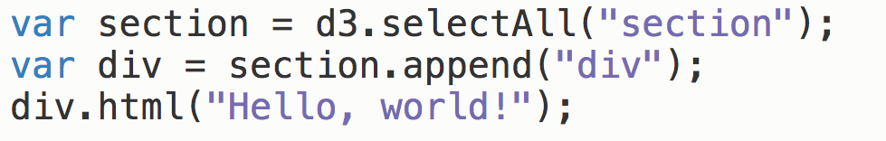
Selecting (many) elements

Slide 18
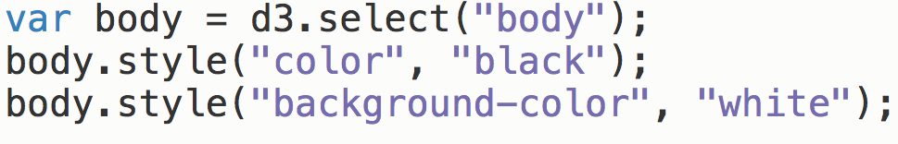
Chaining methods

Slide 19
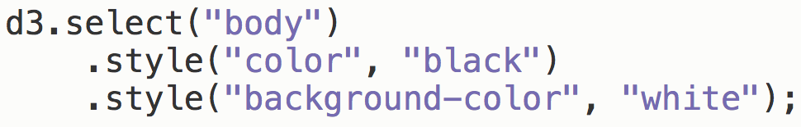
Chaining methods

Slide 20
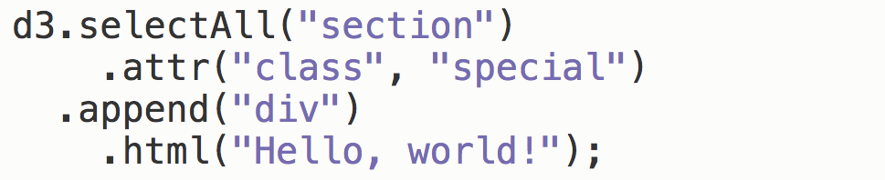
Chaining methods

Slide 21
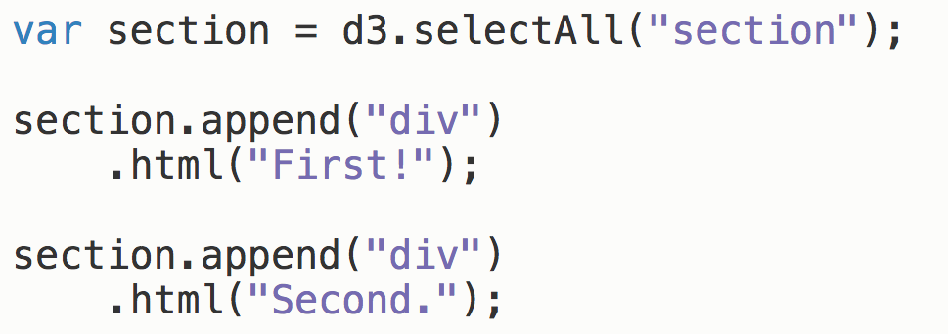
Store selection in variables
Notes:
https://bost.ocks.org/mike/bar/
http://codepen.io/mbostock/pen/Jaemg

Slide 22


Slide 23
Working with D3 recap

Slide 24
D3’s data model
visual form
data
selection

Slide 25
D3’s data model
bind with
.data()
visual form
data
selection

Slide 26
D3’s data model
encode with
.enter(), .attr(), etc
bind with
.data()
visual form
data
selection

Slide 27
D3’s data model
encode with
.enter(), .attr(), etc
bind with
.data()
visual form
data
selection

